Slide 1


Fall 2019
CS101, Dept. of CSE

Slide 2
Boolean Expressions
The Boolean data type contains two Boolean values, denoted as True and False in Python.
A Boolean expression is an expression that evaluates to a Boolean value.
Boolean expressions are used to denote the conditions for selection and iterative control statements.

Slide 3
Relational Operators
Relational expressions are a type of Boolean expression, since they evaluate to a Boolean result.
These operators not only apply to numeric values, but to any set of values that has an ordering, such as strings.
Note the use of the comparison operator == for determining if two values are equal. This, rather than the (single) equal sign = is used since the equal sign is used as the assignment operator.
This is often a source of confusion for new programmers,
num = 10 variable num is assigned the value 10
num == 10 variable num is compared to the value 10

Slide 4
Relational Operators

Slide 5
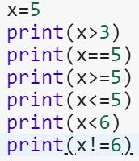
Example
True
True
True
True
False
True

Slide 6
Membership Operators

Slide 7
Boolean Operators
George Boole, in the mid-1800s, developed what we now call Boolean algebra.
His goal was to develop an algebra based on true/false rather than numerical values.
Boolean algebra contains a set of Boolean ( logical ) operators , denoted by and, or, and not in Python.

Slide 8
Boolean Operators
Logical and is true only when both its operands are true—otherwise, it is false.
Logical or is true when either or both of its operands are true, and thus false only when both operands are false.
Logical not simply reverses truth values—not False equals True, and not True equals False.
Operator | Meaning | Example
and | True if both the operands are true | x and y
or | True if either of the operands is true | x or y
not | True if operand is false (complements the operand) | not x

Slide 9
Boolean Logic Truth Table

Slide 10
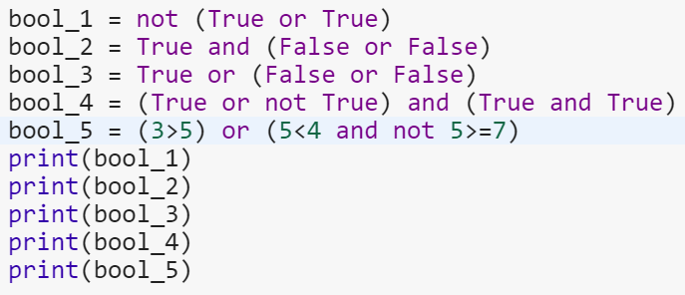
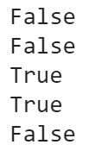
Example

Slide 11
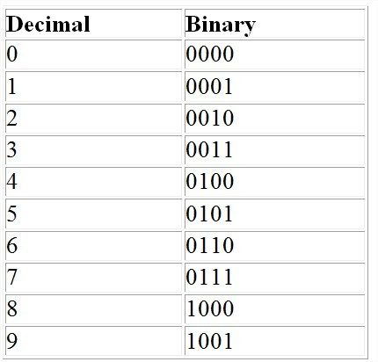
Binary Representation of Decimal Numbers

Slide 12
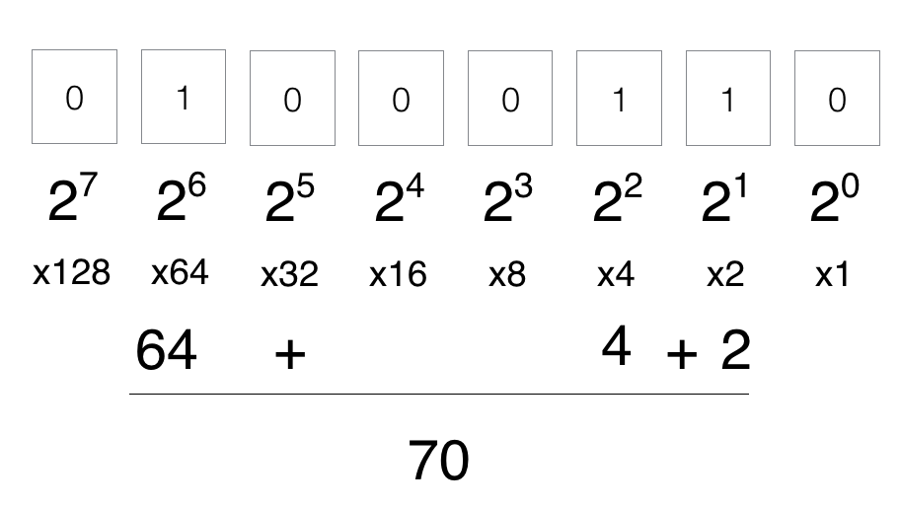
Binary Representation of Decimal Numbers

Slide 13
Bitwise operators
Bitwise operators act on operands as if they were string of binary digits.
It operates bit by bit.
2 is 10 in binary and 7 is 111.
In the table below:
Let x = 10 (0000 1010 in binary) and y = 4 (0000 0100 in binary)

Slide 14
Bitwise operators
Operator | Description
& Binary AND | Operator copies a bit to the result if it exists in both operands
| Binary OR | It copies a bit if it exists in either operand.
^ Binary XOR | It copies the bit if it is set in one operand but not both.
~ Binary Ones Complement | It is unary and has the effect of 'flipping' bits.
<< Binary Left Shift | The left operands value is moved left by the number of bits specified by the right operand.
>> Binary Right Shift | The left operands value is moved right by the number of bits specified by the right operand.

Slide 15
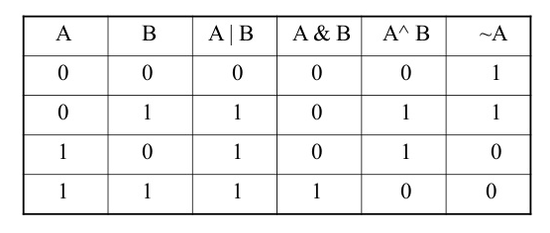
Bitwise operators

Slide 16
Bitwise operators AND OR
5 & 7
Same as 101 & 111.
This results in 101
Which is binary for 5.
4 | 8
Binary for 4 is 0100, and that for 8 is 1000.
After operation, output is 1100
Which is binary for 12.

Slide 17
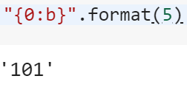
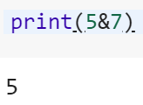
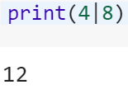


Bitwise operators AND OR XOR

Slide 18
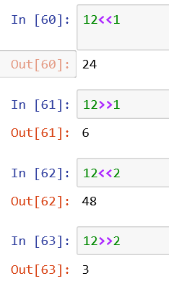
Shift operator
Left Shift (<<)
Right Shift (>>)

Slide 19
Operator Precedence
Operators | Meaning
() | Parentheses
** | Exponent
+x, -x, ~x | Unary plus, Unary minus, Bitwise NOT
*, /, //, % | Multiplication, Division, Floor division, Modulus
+, - | Addition, Subtraction
<<, >> | Bitwise shift operators
& | Bitwise AND
^ | Bitwise XOR
| | Bitwise OR
==, !=, >, >=, <, <=, in, not in | Comparisions, Membership operators
not | Logical NOT
and | Logical AND
or | Logical OR

Slide 20
DATA TYPE CONVERSION Explicit and Implicit
Explicit Data Conversion
We saw this earlier with the int, float, and str built-in functions
E.g., Adding a float and an integer will automatically result in a float value
Takes place automatically during run time between ONLY numeric values
E.g., Adding a string and an integer (or a float) will result in an error since string is not numeric
Implicit Data Conversion
Applies type promotion to avoid loss of information
Conversion goes from integer to float (e.g., upon adding a float and an integer) and not vice versa so as the fractional part of the float is not lost

